Slide 1
Student Gallery

Slide 2
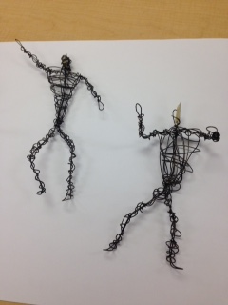
6th Grade

Slide 3
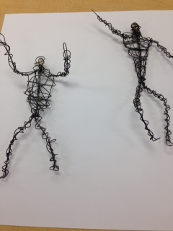
6th Grade

Slide 4

6th Grade

Slide 5

6th Grade

Slide 6
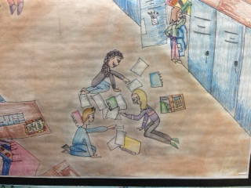
7th Grade

Slide 7
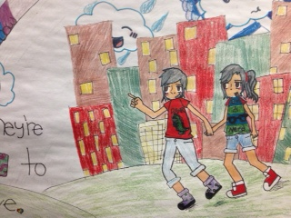
7th Grade

Slide 8
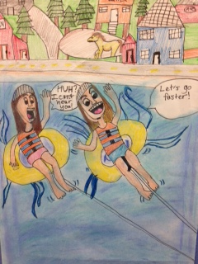
7th Grade

Slide 9
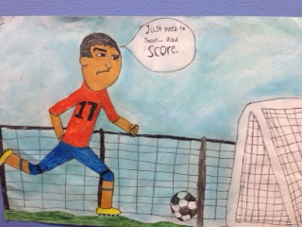
7th Grade

Slide 10
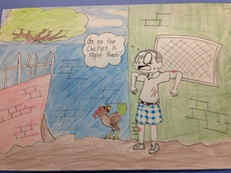
7th Grade

Slide 11
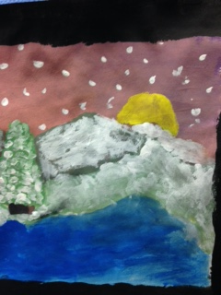
8th Grade

Slide 12
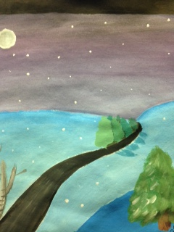
8th Grade

