Slide 1
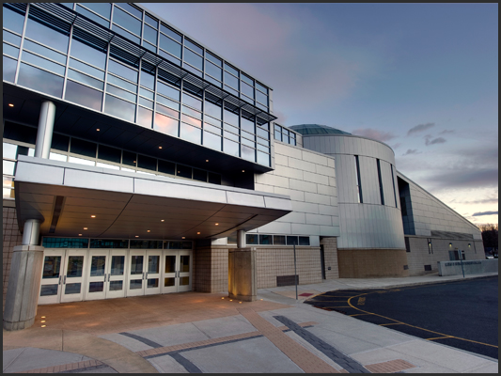
5th Annual Architecture , Engineering and Bio Medical Fair
When: Thursday, April 25, 2013
Where: Academy of Information Technology and Engineering
411 High Ridge Road, Stamford, CT
Time: 7:00 PM – 9:00 PM
aitestamford.org
Schools Attending Include:
Bucknell University, Central Connecticut State University, Cornell, Drexel,
Manhattan College, Marywood University, Merrimack College, Norwalk Community College, Newbury College, NY Institute of Technology, NYU-Poly, Post University, Rochester Institute of technology, Roger Williams, Southern Connecticut State University, Stony Brook University, SUNY-IT, SUNY Maritime, Syracuse, Trinity College, UCONN, UMASS-Lowell, University of Hartford, University of New Haven, University of Southern Maine, University of Vermont, US Coastguard, US Marine Corps, Vaughn College of Aeronautics, Wentworth University, Western New England College and more.

